Slide 1
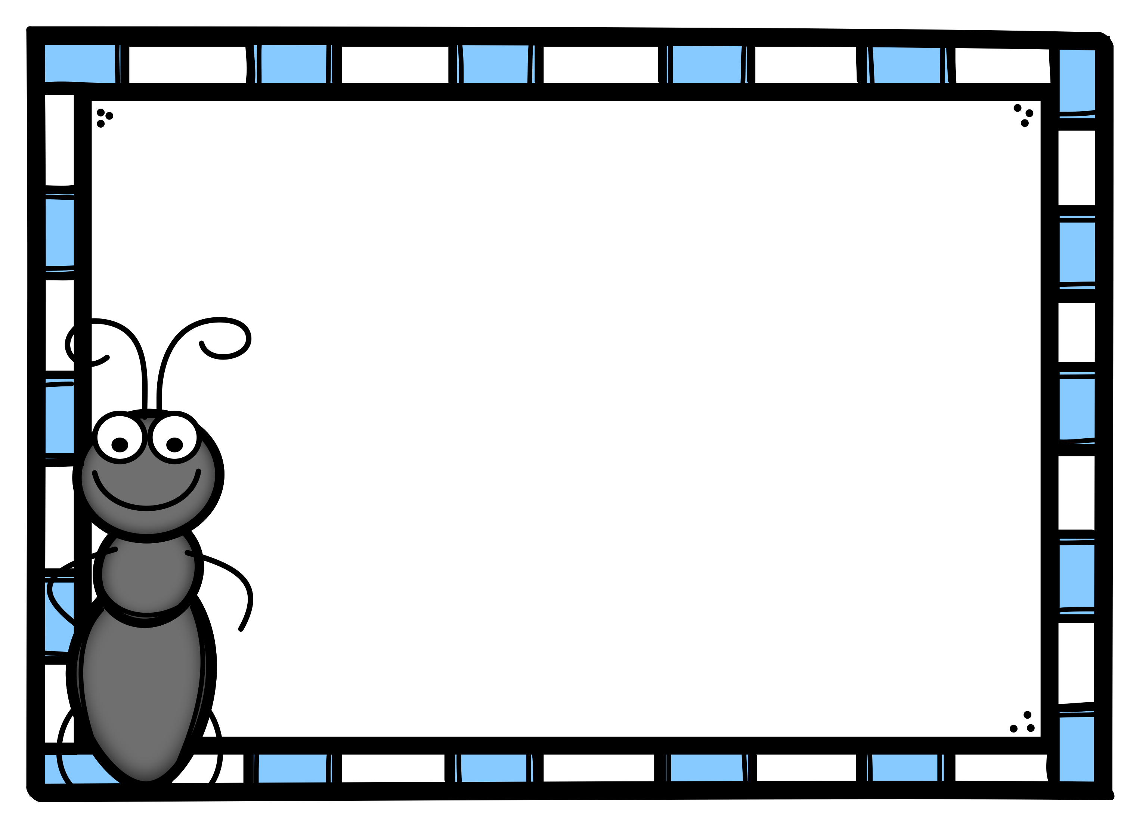
Place Value Names up to Thousands
Click here to start.

Slide 2
1. Where is the digit 6?
926
a. ones place
b. tens place
c. hundreds place

Slide 3
OOPS!
Try Again.
Click here to go back
to the problem.

Slide 4
WAY TO GO!!
Click here to go the
next problem.

Slide 5
2. Where is the digit 9?
962
a. ones place
b. tens place
c. hundreds place

Slide 6
OOPS!
Try Again.
Click here to go back
to the problem.

Slide 7
WAY TO GO!!
Click here to go the
next problem.

Slide 8
3. Where is the digit 6?
468
a. ones place
b. tens place
c. hundreds place

Slide 9
OOPS!
Try Again.
Click here to go back
to the problem.

Slide 10
WAY TO GO!!
Click here to go the
next problem.

Slide 11
4. Which digit is in the hundreds place? 370
a. 3
b. 7
c. 0

Slide 12
OOPS!
Try Again.
Click here to go back
to the problem.

Slide 13
WAY TO GO!!
Click here to go the
next problem.

Slide 14
5. Where is the digit 1?
371
a. ones place
b. tens place
c. hundreds place

Slide 15
OOPS!
Try Again.
Click here to go back
to the problem.

Slide 16
WAY TO GO!!
Click here to go the
next problem.

Slide 17
6. Where is the digit 1?
710
a. ones place
b. tens place
c. hundreds place

Slide 18
OOPS!
Try Again.
Click here to go back
to the problem.

Slide 19
WAY TO GO!!
Click here to go the
next problem.

Slide 20
7. Where is the digit 7?
793
a. ones place
b. tens place
c. hundreds place

Slide 21
OOPS!
Try Again.
Click here to go back
to the problem.

Slide 22
WAY TO GO!!
Click here to go the
next problem.

Slide 23
8. Where is the digit 7?
2,793
a. ones place
b. tens place
c. hundreds place
d. thousands place

Slide 24
OOPS!
Try Again.
Click here to go back
to the problem.

Slide 25
WAY TO GO!!
Click here to go the
next problem.

Slide 26
9. Which digit is in the ones place? 2,173
a. 7
b. 3
c. 2
d. 1

Slide 27
OOPS!
Try Again.
Click here to go back
to the problem.

Slide 28
WAY TO GO!!
Click here to go the
next problem.

Slide 29
10. Which digit is in the tens place? 3,842
a. 2
b. 8
c. 3
d. 4

Slide 30
OOPS!
Try Again.
Click here to go back
to the problem.

Slide 31
WAY TO GO!!
Click here to go the
next problem.

Slide 32
11. Which digit is in the thousands place? 9,403
a. 4
b. 9
c. 3
d. 0

Slide 33
OOPS!
Try Again.
Click here to go back
to the problem.

Slide 34
WAY TO GO!!
Click here to go the
next problem.

Slide 35
12. Where is the digit 0?
9,104
a. ones place
b. tens place
c. hundreds place
d. thousands place

Slide 36
OOPS!
Try Again.
Click here to go back
to the problem.

Slide 37
WAY TO GO!!
Click here to go the
next problem.

Slide 38
13. Where is the digit 6?
7,564
a. ones place
b. tens place
c. hundreds place
d. thousands place

Slide 39
OOPS!
Try Again.
Click here to go back
to the problem.

Slide 40
WAY TO GO!!
Click here to go the
next problem.

Slide 41
14. Where is the digit 4?
3,487
a. ones place
b. tens place
c. hundreds place
d. thousands place

Slide 42
OOPS!
Try Again.
Click here to go back
to the problem.

Slide 43
WAY TO GO!!
Click here to go the
next problem.

Slide 44
15. Which digit is in the hundreds place? 2,681
a. 1
b. 6
c. 8
d. 2

Slide 45
OOPS!
Try Again.
Click here to go back
to the problem.

Slide 46
WAY TO GO!!
Click here to go the
next problem.

Slide 47
16. Where is the digit 7?
867
a. ones place
b. tens place
c. hundreds place

Slide 48
OOPS!
Try Again.
Click here to go back
to the problem.

Slide 49
WAY TO GO!!
Click here to go the
next problem.

Slide 50
17. Where is the digit 4?
942
a. ones place
b. tens place
c. hundreds place

Slide 51
OOPS!
Try Again.
Click here to go back
to the problem.

Slide 52
WAY TO GO!!
Click here to go the
next problem.

Slide 53
18. Which digit is in the ones place? 1,482
a. 1
b. 8
c. 2
d. 4

Slide 54
OOPS!
Try Again.
Click here to go back
to the problem.

Slide 55
WAY TO GO!!
Click here to go the
next problem.

Slide 56
19. Which digit is in the tens place? 7,645
a. 6
b. 5
c. 4
d. 7

Slide 57
OOPS!
Try Again.
Click here to go back
to the problem.

Slide 58
WAY TO GO!!
Click here to go the
next problem.

Slide 59
20. Which digit is in the hundreds place? 3,208
a. 0
b. 2
c. 3
d. 8

Slide 60
OOPS!
Try Again.
Click here to go back
to the problem.

Slide 61
WAY TO GO!!
Click here to finish.

Slide 62
HOORAY, YOU FINISHED!
Click here if you
want to start over.

